Slide 1
Non-parametric techniques
Mann-Whitney Test
Wilcoxon Signed Rank Test

Slide 2
When to use nonparametric tests
It is not always possible to correct for problems with the distribution of a data set but when data violate the assumptions of parametric tests we can sometimes find an equivalent nonparametric test
Nonparametric tests make fewer assumptions about the type of data on which they can be used.

Slide 3
Ranking
Non-parametric tests usually overcome the problem of the shape of the distribution of scores by ranking the data - finding the lowest score and giving it a rank of 1, then finding the next highest score and giving it a rank of 2, and so on.
This process results in high scores being represented by large ranks, and low scores being represented by small ranks. The analysis is then carried out on the ranks rather than the actual data. By using the ranks we eliminate the effect of outliers:
There is a price to pay: by ranking the data we lose some information about the magnitude of differences between scores. Non-parametric tests can be less powerful than their parametric counterparts.

Slide 4
Common Non-parametric tests
Mann-Whitney/Wilcoxon rank-sum Test
  Compares two independent groups of scores
Wilcoxon signed rank Test
  Compares two dependent groups of scores
Kruskal-Wallis Test
  Compares > 2 independent groups of scores
Friedman’s Test
  Compares > 2 dependent groups of scores

Slide 5
Mann–Whitney test
Wilcoxon rank-sum test (alternative)
These tests are the non-parametric equivalent of the independent samples t-test.
If there’s no difference between the groups then you should find a similar number of high and low ranks in each group;
If there was a difference between the groups. you would expect a preponderance of higher ranks in one group and lower ranks to be in the other group.
The Mann–Whitney and Wilcoxon rank-sum tests both work on this principle.

Slide 6

Mann–Whitney test statistic
The Mann–Whitney test is based on a test statistic U, calculated by statistics software using an equation in which n₁ and n₂ are the sample sizes of groups 1 and 2 respectively, and R₁ is the sum of ranks for group 1

Slide 7
Exploratory analysis on Data
Normally, exploratory analysis (especially Normality and Homogeneity of Variance tests) would be conducted on the data to establish if the alternative parametric test could be used.

Slide 8
SPSS shows us the distribution of ranks in the two groups (alcohol and ecstasy) and the mean rank in each condition
The rows labelled Asymptotic Sig. and Exact Sig. tell us the probability that a test statistic of at least that mag- nitude would occur if there were no difference between groups. The fact there are two p-values simply reflects two different ways to compute them;

Slide 9
Example – Drug Experiment
Source: Andy Field, Discovering Statistics using SPSS
A neurologist investigated the depressant effects of certain recreational drugs.
  Tested 20 clubbers
  10 were given an ecstasy tablet to take on a Saturday night
  10 were allowed to drink only alcohol.
  Levels of depression were measured using the Beck Depression Inventory (BDI) the day after and midweek.

Slide 10
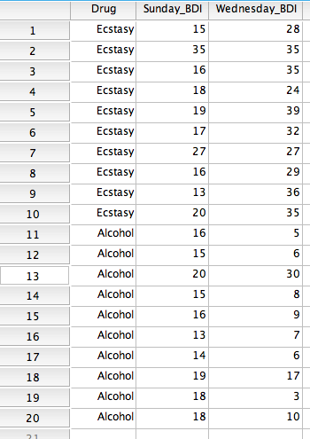
Data for Drug Experiment
Source: Andy Field, Discovering Statistics using SPSS
Because the data are collected using different participants in each group, we need to input the data using a coding variable.
For example, ‘Drug’ with the codes; 1 = ecstasy group and 2 = alcohol group.
When you enter the data into SPSS remember to tell the software that a code of 1 represents the group that was given ecstasy and a code of 2 represents the group that was restricted to alcohol.

Slide 11
Test for Normality
Test for Normality – need to run analysis for each group separately
Analyse – Desc. Stats – Explore

Slide 12
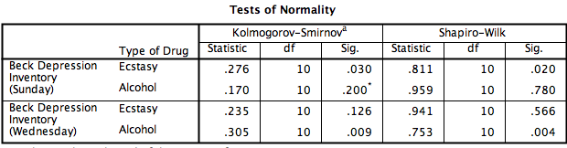

Slide 13
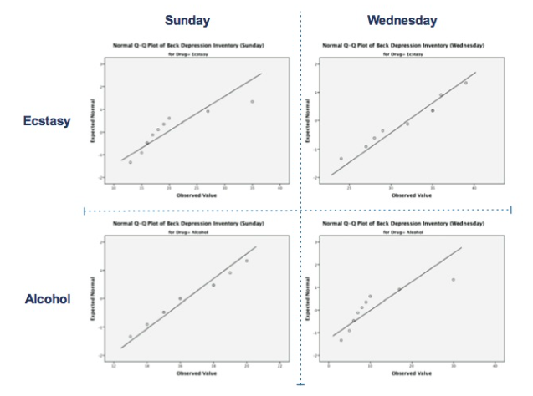

Slide 14
Normality & Homogeneity of Variance
Interpreting Output
Testing for normality
  Sunday data:
    Ecstasy, D(10) = 0.28, p = .03 (non normal)
    Alcohol, D(10) = 0.17, p = .20 (normal)
  Wednesday data:
    Ecstasy, D(10) = 0.24, p = .13 (normal)
    Alcohol, D(10) = 0.31, p = .01 (non normal)
  A non-parametric test should be used.
Results of Levene’s test
  The assumption of homogeneity has been met:
    Sunday data, F(1, 18) = 3.64, p = .07.
    Wednesday, F(1, 18) = 0.51, p = .49.

Slide 15
Non-parametric approach to the Drug Test Data
Rank the data ignoring the group to which a person belonged
  A similar number of high and low ranks in each group suggests depression levels do not differ between the groups.
  A greater number of high ranks in the ecstasy group than the alcohol group suggests the ecstasy group is more depressed than the alcohol group.

Slide 16
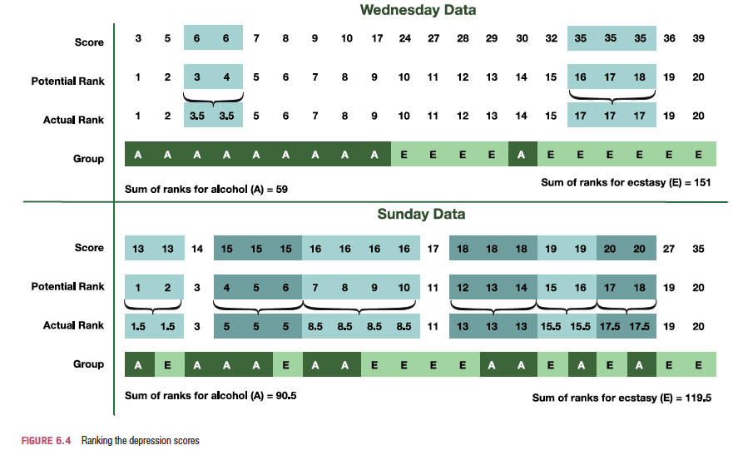
Ranking the Depression scores

Slide 17
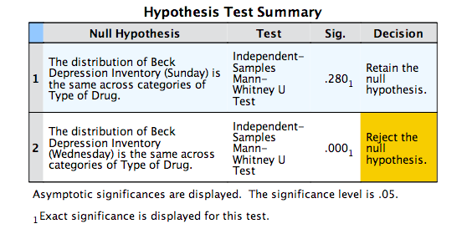

Slide 18
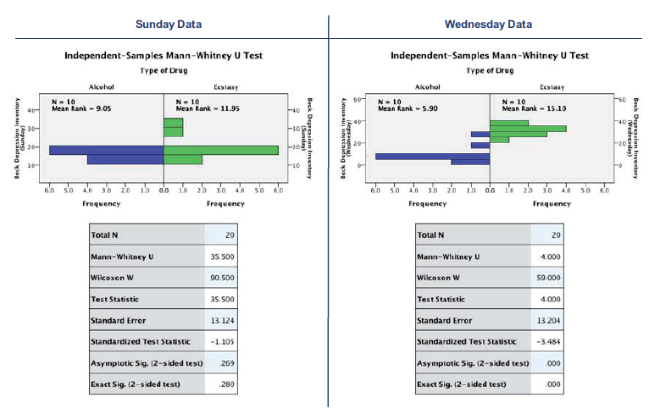

Slide 19
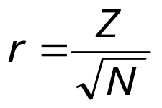


Calculating an Effect Size
The equation to convert a z-score into the effect size estimate, r, is as follows
  z is the z-score that SPSS produces
  N is the size of the study (i.e. the number of total observations)
  We had 10 ecstasy users and 10 alcohol users and so the total number of observations was 20.

Slide 20
Reporting the Results
For the Mann–Whitney test:
  Depression levels in ecstasy users (Mdn = 17.50) did not differ significantly from alcohol users (Mdn = 16.00) the day after the drugs were taken, U = 35.50, z = −1.11, p = .280, r = −.25. However, by Wednesday, ecstasy users (Mdn = 33.50) were significantly more depressed than alcohol users (Mdn = 7.50), U = 4.00, z = −3.48, p < .001, r = −.78.

Slide 21
Mann-Whitney Test
Summary
The Mann–Whitney test (and Wilcoxon rank-sum test) compare two conditions when different participants take part in each condition and the resulting data have unusual cases or violate any assumptions for parametric tests
Look at the row labelled Asymptotic Sig. or Exact Sig. (if your sample is small). If the value is less than .05 then the two groups are significantly different.
The values of the mean ranks tell you how the groups differ (the group with the highest scores will have the highest mean rank).
Report the U statistic (or W_{s} if you prefer), the corresponding z and the significance value. Also report the medians and their corresponding ranges (or draw a boxplot).
Calculate the effect size and report this too.

Slide 22
Reporting Results (example)
Depression levels in ecstasy users (Mdn = 17.50) did not differ significantly from alcohol users (Mdn = 16.00) the day after the drugs were taken, U = 35.50, z = −1.11, p = .280, r = −.25. However, by Wednesday, ecstasy users (Mdn = 33.50) were significantly more depressed than alcohol users (Mdn = 7.50), U = 4.00, z = −3.48, p < .001, r = −.78.
The median is a more appropriate statistic than the mean for non-parametric tests.

Slide 23
Wilcoxon signed-rank test

Slide 24
Comparing two related conditions: the Wilcoxon signed-rank test
Uses:
  To compare two sets of scores, when these scores come from the same participants.
Imagine the experimenter was interested in the change in depression levels for each drug.
  Non-parametric test because the distributions of scores for both drugs were non-normal on one of the days.

Slide 25
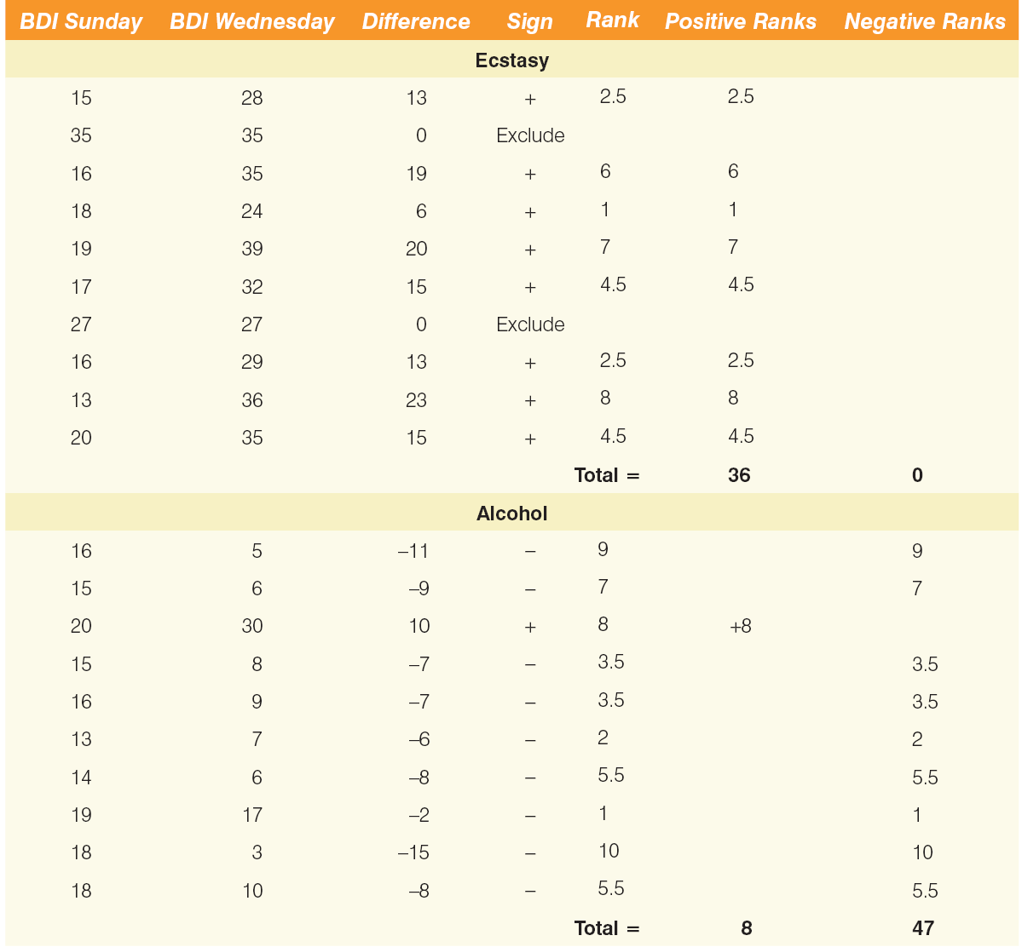
Ranking data in the Wilcoxon signed-rank test

Slide 26
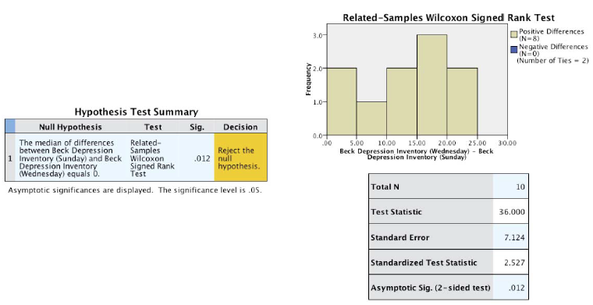
Output for the Ecstasy Group

Slide 27
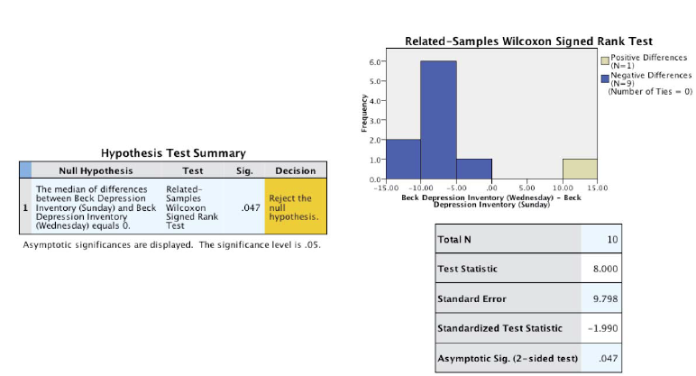
Output for the alcohol group

Slide 28
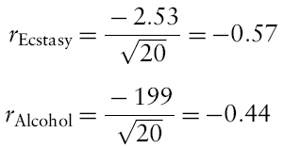
Calculating an Effect size
The effect size can be calculated in the same way as for the Mann–Whitney test.
In this case SPSS Output tells us that for the ecstasy group z is –2.53, and for the alcohol group is −1.99.
In both cases we had 20 observations
  (although we only used 10 people and tested them twice, it is the number of observations, not the number of people, that is important here).
The effect size is therefore:

Slide 29
Reporting the results
Reporting Test-Statistic:
  For ecstasy users depression levels were significantly higher on Wednesday (Mdn = 33.50) than on Sunday (Mdn = 17.50), T = 36, p = .012, r = .57. However, for alcohol users the opposite was true: depression levels were significantly lower on Wednesday (Mdn = 7.50) than on Sunday (Mdn = 16.0), T = 8, p = .047, r = −.44.
Reporting the values of z:
  For ecstasy users, depression levels were significantly higher on Wednesday (Mdn = 33.50) than on Sunday (Mdn = 17.50), z = 2.53, p = .012, r = .57. However, for alcohol users the opposite was true: depression levels were significantly lower on Wednesday (Mdn = 7.50) than on Sunday (Mdn = 16.0), z = −1.99, p = .047, r = −.44.

Slide 30
Wilcoxon signed-rank test - summary
The Wilcoxon signed-rank test compares two conditions when the same participants take part in each condition and the resulting data have unusual cases or violate a parametric assumption
Look at the row labelled Asymptotic Sig. (2-sided test). If the value is less than .05 then the two conditions are significantly different.
Look at the histogram and numbers of positive or negative differences to tell you how the groups differ (the greater number of differences in a particular direction tells you the direction of the result).
Report the t-statistic, the corresponding z, the exact significance value and an effect size. Also report the medians and their corresponding ranges (or draw a boxplot).

Slide 31
Non-parametric techniques
Mann-Whitney Test
Wilcoxon Signed Rank Test

